Slide 1
Welcome to the UCAS, Gap Year and Careers Information Evening
Please help yourselves to refreshments and browse through the prospectuses or use the iPads to visit university websites
Notes:
Thank you very much indeed for coming this evening. When students, parents and staff work closely together we get a much better result.

Slide 2
Schedule
Principles to guide your choices
How to choose a university, course or career
Writing an excellent personal statement
Student finance
Filling out the UCAS form
Notes:
First I want to talk briefly through our principles and aims for careers and university applications after you leave Cheney. Then I will talk about how to choose a course, and how to write an excellent personal statement. Emily Jones from Oxford Brookes University will talk about student finance and I will finish the practicalities of the application form.

Slide 3
Principles
University, a Gap Year, apprenticeship or other alternatives should be a positive choice, not a default option.
Students should investigate a range of opportunities, even if they think they know what they want to do – just to make sure.
Notes:
It is very important to emphasise that university is not the only option.

Slide 4
Why higher education?
Increase potential earnings*
Better career prospects
Benefit the wider community
Social and cultural reasons
More independence, self-confidence and responsibility
Personal challenge
Broadens interests and knowledge
Better health
It can be immense fun!
*Source: Pricewaterhouse Coopers LLP, 2006, in Universities UK, Research Report, The Economic Benefits of a Degree
Notes:
UCAS gives the following reasons for applying to university – and a university degree is indispensable for many professions. However, most of the benefits listed could also be achieved in other ways. The fact, that, for example, university graduates tend to earn more than those who leave school just with A Levels, does not mean that you personally will necessarily earn more, or be happier, by going to university. There is strong evidence that not all university degrees lead to higher earnings. Apprenticeships which integrate on-the-job learning with more formal study, lead to a range of rewarding careers – and also of course, sometimes to degree courses. Alternatively, you might want to explore the courses offered by the Open University which allow you to study for an highly valued academic degree at your own pace while working. If you are very brave, you might even want to work for yourself – some (thought certainly not all) successful entrepreneurs have started from scratch without formal qualifications. In tomorrow’s visit to the UCAS Convention at Brunel University, you will be able to get an idea of some of the range of interesting opportunities which are possible if you take a year out – you may want to do this given that you will have just spent thirteen years in full time education.

Slide 5
Principles
University, a Gap Year, apprenticeships or other alternatives should be a positive choice, not a default option.
Time spent researching a variety of options is rarely wasted
Cheney’s job is to help you find the right individual pathway for you, not to push you in a particular direction.
Notes:
Probably the most important point that I want to make this evening is that whatever you do, don’t do it because it is the default option. Whatever you choose, choose it because it is a proper researched and thought through choice. Whether you are going to apply for a highly competitive apprenticeship scheme, spent fourteen months of your life on a gap year educating yourself outside the formal structures of school and university, or invest three years and borrow £50,000 to get a university degree, it is essential that you do your homework. Time spent in reconnaissance will certainly not be wasted.
Much of what I am going to say now will apply largely to those of you who are planning to go to university in the UK – but it will also have relevance for anyone planning to go to university outside the UK or to pursue other career paths. The specifics of what I am going to say deal with the coming UCAS cycle of applications in the autumn of 2019 for admission in the autumn of 2020. Most of you in this room will be applying in this cycle for five courses, awaiting your offers, and probably ending up with one firm offer and one insurance offer by the late spring of 2020 – I will explain the mechanics of this later.

Slide 6
Course Choice
Refining an existing career plan
Pursuing an area of interest
Make choices based on the course, but then consider location, type of university (city/campus etc.), accommodation, costs, student support, extra-curricular opportunities etc.
Check grade requirements and have a balance of aspirational, secure, and insurance choices
Attend a couple of Open Days and ask lots of questions.
Notes:
Firstly, course choice:
Some of you already have a very clear idea of what you want to do. For you the process you need to go through between now and September is one of refining your choice so that you find the right niche. Those of you who have attended various Medicine events will be able to use the guidance given there to match your GCSE and likely A Level, UKCAT and BMAT qualifications with the very varied criteria employed by medical schools for admission – and to decide what will be the best way to learn medicine for you. If you know you want to read English, you will want to explore the different approaches to teaching and enjoying literature at different universities – to decide if you want a course offering a broad overview or if you want the chance to specialise in something like American literature, and maybe take up the opportunity to spend a year in the US.
Some of you will not have a definite career path in mind yet. There is no problem with that. If that is the case, choose to study something you will really love – going to university is about acquiring skills which you can deploy in any working context later in life. There is an enormous range of jobs available for university graduates with a broad general education.
The UCAS website is your best starting point for choosing a range of courses, and then refining your choice. It has a very valuable range of basic information and links to every one of the 38,000 different courses which you can apply to through UCAS. There are many other good websites listed in the online Cheney UCAS booklet, which you can find on the Cheney website – an update for 2020 will appear in June. The most important thing is to identify the course or courses which are going to be right for you. You will need to look carefully at the content of each course and how it is taught to confirm that it meets your interests and preferred way of learning. I am sceptical about league tables of teaching quality and student satisfaction – there is no harm in checking them out, but they are only a starting point. You need to dig a bit deeper into the course information to get a better idea of its quality and suitability for you. It is a very good idea to discuss your findings with your parents or carers, with older siblings and with other adults, including subject teachers who may also have useful advice. You may want to consider doing Joint Honours or another course which allows you to take more than one subject – this can liberate you from the narrow specialism which is such a feature of English as supposed to US universities, though the experience of Cheney students suggests that Joint Honours can be demanding if both your subjects want more than 50% of your time.
Once you have identified courses which you like, it is then worth measuring them up against other criteria – is the university in the right geographical location for you, do you like the fact that it is a big city/small town/campus university, is the accommodation the kind you want, what does it cost, and what financial or other support can the university provide. For some people a central London university is just the right place to be – as long as you don’t find yourself in a remote hall of residence near Heathrow. Sheffield or Stirling would be much cheaper and much better if you like hill-walking or rock-climbing.
Of course the critical thing to check is that you are likely to meet the admissions requirements for your chosen courses. It is entirely reasonable to make one or perhaps two of your choices aspirational ones. For example, if you get BBB in your UCAS Predictor/End of Year exams, it would fine to chose one course requiring ABB at A Level , as long as your teachers felt that they could realistically predict you an A in at least one subject. It would be wise also to make two or three choices which are more secure (perhaps BBB), including one which could act at an insurance choice (maybe BCC) if you do worse than expected at A Level.

Slide 7
How can you support the research process?
Sign up to the monthly UCAS Parents’ Newsletter.
Download the 2019 UCAS Parent Guide from the UCAS website – the 2020 guide will be available in due course
Offer to attend open days with them as you may have a different perspective.
Financial assistance – for example, with railway tickets.
Try to remain impartial.
Visit
www.ucas.com/parents
Notes:
The UCAS Convention to which almost all Year Twelves are going tomorrow will be a very good way to sample what is on offer from a wide range of universities, and to talk to admissions staff. The next step which will follow from this will be to go to individual Open Days – it isn’t necessary, or easily feasible, to visit all of the five universities which you can put down on your UCAS form, but I think it is a good idea to visit two different universities if you can. This may require rather careful scheduling this year – Cheney’s internal UCAS Predictor/End of Year exams are in the week beginning Monday 3rd June and you must be here for them. It is fine to go to Open Days by yourself but it can also be very helpful to visit with parents – most universities provide talks for parent visitors as well as for students. Over and above the formal programme, it is very important to talk to as many staff and students as possible to establish how well the university looks after its undergraduates – you want to be certain that you are getting a really good deal for the £9,250 in fees which most universities charge annually. I would be really interested in asking students how good the lectures are, how much personal contact they have with teaching staff, and how detailed the feedback is which they receive on written work. It would also be really good to know about the onward career pathways of graduates. UCAS offers the above advice to parents on how to support this process.

Slide 8
Work Experience
Officially from 10th to 14th June but could be at any time during the summer holidays.
Talk to staff/Mr Davis and contact employers with short CV and covering letter written in EPQ/Study Skills lessons in the autumn. Ring in advance to make sure that you know who to write to, make your letter very specific to the person addressed.
Must be enriching but unpaid – can be done in over several individual visits to different places rather than in a block. Could include anything that will make you a better university student – summer schools also count as work experience.
Notes:
Another way to decide what you want to do is through Work Experience – officially this takes place in the week beginning Monday 10th June. Especially if you are planning on a vocational course like Medicine, Nursing, Teaching, Engineering or Law, it is very important that you demonstrate to universities that you have invested time in research and are not going to drop out because you made an uninformed and mistaken choice. You had the opportunity to write CVs and covering letters in supertutor lessons before the October half term. Many of you have already contacted employers, carefully phoning in advance to make sure that your one side covering letter and mini-CV is directed to the right person. Most people are very busy but most people also want to help young people entering their profession and will be ready to do so if it is clear that they have a good command of formal English – check and double-check your spelling etc. – and have done their homework about what their company actually does. A student I worked with recently went to visit some of the projects completed by the firm she was applying to, and mentioned them in her letter. Another student interested in Law went to sit in at the Crown Court and by talking to the court staff made contacts who have offered work experience. If you are applying for a more general degree like English or Natural Sciences, there are a wide range of opportunities which will help to demonstrate your broad intellectual interests and ability to get stuck into things. From the school perspective, any activity which will enrich your application, which is out of school, and which is unpaid will count as work experience. A private language exchange is an acceptable alternative to conventional work experience, for example. You don’t have to do all your work experience in one block – you could do a number of individual days shadowing people in possible areas of work.

Slide 9
Personal Statement
4,000 characters – five paragraphs – one side
Written very slowly, but read at great speed
Needs to be very specific – no need to show off, but detail lends credibility.
Y12 will have a Personal Statement be in their next EPQ Study Skills lessons.
Notes:
Once you have decided what courses you would like to apply for, the next step is to finalise your 4000 character, five paragraph, one side personal statement. You only get to put one personal statement on your application form, so it will need to be relevant to all the five courses which you are applying for. This can be awkward if you are applying for History and Politics at Newcastle but History and Sociology at Manchester. Individual universities don’t know where else you have applied to, or for what, but they are broadly happy with the idea that applicants won’t necessarily apply for the same courses at each of their five choices, so it is fine for your Personal Statement to be about broad areas of interest rather than specific courses. On the other hand, if, for example, you are applying for Geography at five different institutions, then it is obviously easier to talk very specifically about Geography as a course.
We will spend our next Supertutor lessons writing draft Personal Statements, with the support of your supertutors. The most important thing that you will need to show in your 4,000 character Personal Statement is that you are interested in the course which you have chosen, and that you are a self-reliant and independent student ready for university study. The best way to do this is to make sure that you provide specific examples of all the things which you have done and can offer. It is important to remember than admissions tutors and staff read very large numbers of personal statements, very quickly. They need to decide whether you are worth an offer in less than a minute. General statements about your love of a subject or of ‘reading’ do not make their job any easier – they can already infer that you love their subject because you have applied to spend three years studying it, and it should be assumed that you enjoy reading if you plan taking a course which will require you to read for at least twenty hours a week. It is very important to demonstrate that you have already pursued your chosen subject independently and in depth, and that you have really thought about it. You don’t have to have had any special advantages in life to do this. It cuts no ice to say – in a Biology or Geography Personal Statement – that you have been to the Great Barrier Reef. You have to say something informed about how to tackle the threats to the reef caused by climate change, or something interesting about how it works as an ecosystem. It would be just as, if not more, impressive to explain your fieldwork helping to investigate some of the 222 species of bee and wasp and the 992 kinds of beetles identified in Shotover Country Park.
Fully two-thirds of your Personal Statement should be about your chosen course and how your A Levels and independent study prepare you for it. The other third can be about your other interests and activities – if they suggest that you have good time management, stamina, broad interests, and will contribute a lot to your university, they will certainly strengthen your application.

Slide 10
I would like to study computer science because it is something I enjoy doing - there is a lot of freedom to create programs my own way. I participated in a Villiers Park course on Computer Science and I was particularly interested in the sessions we did on computer graphics in OpenGL. I used python to program balls to bounce as if they were affected by gravity. Another interesting feature was computer security and cryptography; I heard a lecture on the use of codes in computing, especially the use of an asymmetric cipher in communication. We also visited Bletchley Park and saw Colossus and Turing Machines working whilst hearing a talk of how they were used to crack codes such as Lorenz and Enigma. I read further on this topic. "The Code Book" by Simon Singh was especially interesting since it delved into modern computer cryptography such as Pretty Good Privacy (PGP) and particularly quantum computing, a topic I heard a lecture on at a Bristol Open Day. I was accepted to take part in four weeks' work experience organised by the Nuffield Foundation. My placement was in Milton Park at Sensium Healthcare. I was tasked to design a model, using C#, which showed how various low power radios connect to frequency channels and how they interact with other radios to avoid colliding on the same frequency and causing interference. I designed the model and presented it to the team I was working with. From that I created the model as a computer application. I completed the original design early. This meant I could add additional features and they have asked me to return in January to show the model in more detail. It is exciting to know my model will be useful.
Notes:
With permission, I would like to show you extracts from some of recent personal statements produced at Cheney. Out of respect to the students who have kindly agreed for them to be used, I don’t want to do this an exercise in deciding which one is best, but I think it would useful for you to read them and to highlight, in any colour, all the places where specific detail has been used. You might want to reflect on ways in which the prose could become even pithier and to the point. The more you can say, with the fewer words, the better. Please read these extracts, and to have a leaf through some of the publications provided by universities, or to use these i-Pads to start investigating the UCAS and other websites. Please do help yourselves to more tea, coffee or squash and do feel free to ask Ms. Hackett, Ms Warbrick or I any individual questions. You can write these on the large A3 sheets on each table and I will try to answer them all in the second half of my talk.

Slide 11
My decision to apply for degrees in Economics has stemmed from talking to employees at major firms such as Deloitte, Ernst and Young and Mazars. While visiting the KPMG offices in Canary Wharf I enjoyed the corporate, professional and competitive environment there and my ambition is to work for one of the top ten firms. My sister works in one of the leading professional service firms and seeing her work and talking to her has given me a good grounding in how to cope and be successful in the professional service sector. There are many service lines such as auditing, tax, advising and transaction within accountancy and an understanding of economics is fundamental to being successful at performing those roles. I enjoy mathematical and statistical tasks and most of all enjoy working as part of a team. I wholeheartedly believe that the skills I have developed at A Level and the strengths I already have can be transferred and maximized at degree level. My A Level in Economics will help me have a sufficient grounding in theoretical and practical aspects of business. My eagerness to learn about economics and especially its effects on society has led me to do further reading and attend talks. I have read "Poor Economics" and "The Spirit Level". These have taught me about the obstacles, consequences and possible solutions to social inequality in LEDC and MEDC countries. I have attended talks by Tim Harford and Robert Peston, and I learned the extent to which the global economy has recovered from the 2008 economic crash and the expected progress of it and the correlation between inflation and unemployment through the Bill Phillips curve. The recent event of the accounting error which caused Tesco to understate their profits for some years resulting in a profit scandal interests me because I would like to find out how Deloitte investigates this case and how Tesco recovers from this.

Slide 12
In the last two years my interest in geography has developed on varied fronts and for several reasons. My interest in human geography was inspired by studying the impact of the Indian caste system during my World Development AS in Year 11. I found it fascinating that the treatment of the Dalits was widely accepted there but that from my own cultural perspective, it is unjust. I have attended many interesting lectures on social inequality in the UK, by Professor Danny Dorling, University of Oxford. Due to this, I have been motivated to acquire the research skills that would let me explore and identify patterns in different populations. An interest in physical geography and in particular the impact of the environment has been fed by extra-curricular activities as well as personal travel. A lecture series at the Emmanuel Centre in London on Natural Hazards was invaluable preparation for a subsequent ten-day study trip to Morocco seeing the tangible consequences of flooding on the Imlil settlement in the Atlas Mountains.The trip to Morocco was an excellent opportunity to see the interaction of physical and social geography and it was exciting, through fieldwork, to observe the Burgess Model, illustrated in real life Marrakech. I also enjoyed being able to put my French to use in communication with local people. I have spent several weeks in Botswana and South Africa with family friends and found myself fascinated by the use that people have traditionally made of their environment. On a hike over kopjes I was shown huge boulders with small nicks in their surfaces that, thousands of years ago, would have been hit at certain points to create resonances in order to communicate messages over great distances. Witnessing at close hand, the work of the charity "Mothers for All", showed me a sustainable response to a contemporary issue in providing skills for work and education in the fight against HIV/AIDS.

Slide 13
Growing up in Oxford, I have always been surrounded by history. I love the fact that during the Civil War Merton College was used to house King Charles I's wife, Queen Henrietta Maria, whilst he stayed in Christ Church and an underground tunnel was built running between the two. It's these little findings, the thrill of discovering new facts and connections, that make history exciting for me. This year in History I have relished the opportunity to engage in independent research for my personal study on Franco and his significance; what has been most interesting has been comparing and contrasting the views of different historians (such as over how successful Franco was as a military leader), and analysing the different ways in which Franco impacted on Spanish culture and society. At AS I really enjoyed my study of Elizabeth I. Again it was fascinating to contrast the views of different historians such as David Starkey and Christopher Haigh. Complementing my love of history has been an interest in art and architecture, which has helped me develop insights into the material and built cultures of the past, and how these reflected people's beliefs and aspirations. Last year at the National Gallery, I was captivated by an exhibition that included many works by famous Renaissance artists, which helped give immediacy to what I had learned about the Italian Renaissance. This summer I was able to do work experience at the Oxford Dictionary of National Biography, where I helped build a database of potential subjects using obituaries and other sources, and create 'profile sheets' for entries using a wide variety of materials, including birth, marriage and death certificates and probate registers. I found this engagement with the detail of primary research fascinating, and the experience deepened my understanding of how historians work.

Slide 14
The world of journalism is a major factor in the daily lives of most, influencing the way they go about their business and how they interact with others, for better or worse. It has only been in recent times that I have realised that I want to be able to influence how knowledge reaches others, to expand and introduce not only new information for myself, but for the people around me as well. The power of new media means information can be shared and absorbed at an incredible rate, and as such it must be handled with care and talent. A particularly apt case would be the televised debate between David Frost and Richard Nixon. Public opinion was instantly swayed and Nixon was forced to resign to save face, showing the power of good research and technologies ability to push information across the world. For a more modern example, the scandal of the phone hacking by the News of the World has shown me that the opposite is true, that public opinion can be the end of journalistic endeavors. This symbiotic relationship is something I want to study further. A matter of personal interest to me is how modern technology influences the processing and spreading of news and knowledge. With my skills as a writer and an investigator, I believe that journalism is the course that best suits me and my talents.

Slide 15
Oriental Studies
My Extended Project was about the art of translation. I find the difficulty of translating contexts particularly fascinating. In my project I looked at translating political satire from English to Catalan. Different political references need to be used in order to make the humour understood within the culture of the target audience. I see similarities between this method and Yan Fu’s theory of translation, specifically his ideas about dá (expressiveness). I understand this to mean making the translated text accessible (i.e. equally expressive) to the reader, using a Chinese setting if need be. Although not exactly applicable to literary texts, I feel this was what made the book ‘Brothers’ (Yu Hua) seem slightly jarring to English readers. The Guardian’s reviewer wrote that “the novel is supposed to be funny, but mostly fails to be”. While some elements of comedy were perhaps lost across the cultural border, I think this was too scathing.
Simon Leys’ essay on Poetry and Painting in China prompted me to visit the V&A’s ‘Masterpieces of Chinese Painting 700-1900’. Leys discusses the similarity of these two art forms in China, and looking at the art displayed I definitely had a sense that a painter “writes a painting” (xie hua). I find the Yue-fu and the “Old Poems” of the Eastern Han similarly evocative. Recurring themes such as parting and disillusion reflect the familiar tale of China between dynasties, as warring armies take the place of a strong, centralised government.

Slide 16
Maths has never been work to me - it has always been an immense source of pleasure and
stimulation. I love the sense of creativity and freedom I get when I explore mathematics for
no other purpose than to satisfy myself.
Through my extended project, I have been able to look at mathematics beyond the A-level
syllabus. Asking the question "Could Fermat have proved his Last Theorem?" I investigated
various proofs of specific cases of the Last Theorem, and by comparing them, illustrated that
Fermat simply did not have the knowledge to possess a general proof, as he claimed. The real
joy of the essay was that the history of Fermat's Last Theorem was construed effectively as a
fascinating history of mathematics. From Diophantus' derivation of a general solution to the
Pythagoras equation, to the much more recent proof of the n=3 case of Fermat's Last Theorem
using the Eisenstein integers, attempts to make breakthroughs in the problem have led to
entirely new branches of mathematics. Throughout the project, the most important resource has been Hardy and Wright's An Introduction to the Theory of Numbers that has really got me hooked on number theory and has given me grounding with certain techniques of proof. The elegance of infinite descent has particularly sparked my interest.

Slide 17
Psychology: In the words of Carl Rogers 'it is the direction we go that helps us process the good life, not the destination'. Born in Sinjar, northern Iraq (Kurdistan) and living in the UK for 15
years has helped me build a diverse outlook on life. I have seen first-hand how cruel life
treats those living in poverty, and the threats they face on a daily basis. Such experiences
have compelled me to look deeper into the human mind; how do we maintain sanity in the darkest of times.
During my secondary school experience I have flourished as an individual by partaking in a
number of school programmes; attempting multiple times to step out of the shadows and create a role and purpose for myself. My earlier role of being head of the prom committee gave me leadership skills. Ensuring the success of the committee was key, as expectations were high.
However, taking risks proved to be a success. For example, investing our own money into the
committee had its risks, however, this contribution ensured the quality of the fundraiser and
the total profit that was made was a success. I believe I have managed to build a diverse set
of skills by taking part in student programmes. Being a girls mentor gave me an opportunity to
practice my analytical skills and offer guidance to some of the younger girls' in the school.
My duties ranged from, preparing and presenting presentations to students, pitching
fundraising ideas to staff, planning and organizing events both inside and outside of school
hours. I developed my communication skills from mentoring and by being a school prefect.
My enthusiasm for research stems from working with PhD students in the Amsterdam Medical
Hospital. These students were investigating middle-aged Turkish cervical cancer patients'
understanding of the disease. The majority of women refused to tell their families that they
were or had suffered from cervical cancer because they were afraid that the honour and respect
within the family would become tainted. During my travels from over Europe to Asia I have
learnt that culture seems to be the force that separates one human's behaviour from another,
and behaviour not representative of a culture is deemed abnormal.

Slide 18
I am drawn to science by an awareness of the huge environmental challenges in the modern
world. Biology is what sparked my scientific interest and remains my motivation for broadening
and deepening my scientific understanding. Within the subject I am particularly interested in
ecology and plant science. The idea of a broad view of biology which looks at how organisms
both shape and are shaped by their environment is something that appeals to me. Recently I
have been reading 'An Improbable Primate' by Clive Finlayson, which explores the evolutionary
ecology of humans, arguing that a key driver of human evolution was the search for declining
water sources. It opened my mind to how evolution is triggered by selection pressures in ways
that are not necessarily intuitive.
Partly what drew me to biology was my interest in agriculture. The need to grow more food
without further expansion of agricultural land, with fewer fossil fuel based inputs, and with
a changing climate is something that I think biologists can play an important role in. What
interests me is the diversity of biological solutions to these problems: breeding crops with
new traits, developing safer pesticides, managing land to protect the ecosystem services on
which agriculture depends. In my extended project qualification I wrote an essay on the role
of drought tolerant crops in maintaining yields in water deficit - weighing the importance of
crop breeding against more integrated approaches to improving soil structure and water holding
capacity.
Through my two sciences at A-level I have come to love the scientific way of thinking. Science
can seem quite static when you're learning it at school - like a body of knowledge that has
always been there - but eventually you realise how dynamic and self-correcting it is. I really
look forward to the challenge of making the transition from learning science to doing science
- so I am as keen to learn about the tools scientists use to handle experiments and data as I
am to learn the science itself.

Slide 19
Parental Support
If you have expertise in reading and evaluating personal statements, and would be happy to comment on the Personal Statements of Cheney students applying for courses in your field, please do let me know.
We would like to encourage a network of parents to share their specialisms and support students.
Notes:
If you have expertise in reading and evaluating personal statements, and would be happy to comment on the Personal Statements of Cheney students applying for courses in your field, please do let me know. Alternatively, if you would be ready to ‘advertise’ a work experience placement to Cheney students, I would be very keen to hear from you.

Slide 20
References
Year 12: your support is essential to help your referees do the very best job they can for you.
In June you will be asked to commit to a particular time-slot for your UCAS form to be sent on to UCAS.
Notes:
Whether you are applying to UCAS, for an apprenticeship or for anything else, you will need a reference from Cheney. From mid-May each of your subject teachers will be writing a 750 character reference about your work over the past year, and in June, they will add a predictor largely based on your UCAS predictor results. Supertutors will then arrange them in order (with the subject you are applying for first and then add an introductory paragraph and a concluding paragraph, leading to a one side, five or six paragraph, 4,000 character reference very like the Personal Statement. The references are then forwarded to me and after discussion with Ms. Hackett, they are cut and pasted into your UCAS application. Before they are sent to UCAS, you will see the finalised copy of your reference, and are very welcome to share this with your parents. We show you your reference in part because – very simply – in law (under the Data Protection Act 1998) you have the right to see what is written about you. We are also very keen to avoid making any mistakes of fact, and you have an important role to play in making sure that we do this. I hope that you will all feel that your references are very positive. We very much try to emphasise all your strengths and all the impressive qualities you will bring to university or your employer. On the other hand, it is important to say that the school has final editorial control over what goes into the reference, and that we always try to be strictly honest, whether in our professional judgement of your predicted grades or in our evaluation of your suitability for particular courses. We have a professional duty towards you, but also towards the universities involved and towards other candidates (not least those from Cheney, who would be disadvantaged if Cheney got a reputation for writing exaggerated or inaccurate references). We will try to make your references as individual and as detailed as possible: admissions tutors dislike references which are too full of praise or too generic to help them to distinguish between candidates. Nobody is served well if universities don’t admit the most suitable candidates onto their courses.
It is important that students take responsibility for making sure that their supertutors know about their extra-curricular activities, and make sure their work experience supervisors send a few brief comments into Cheney – these can very definitely strengthen an application significantly.

Slide 21
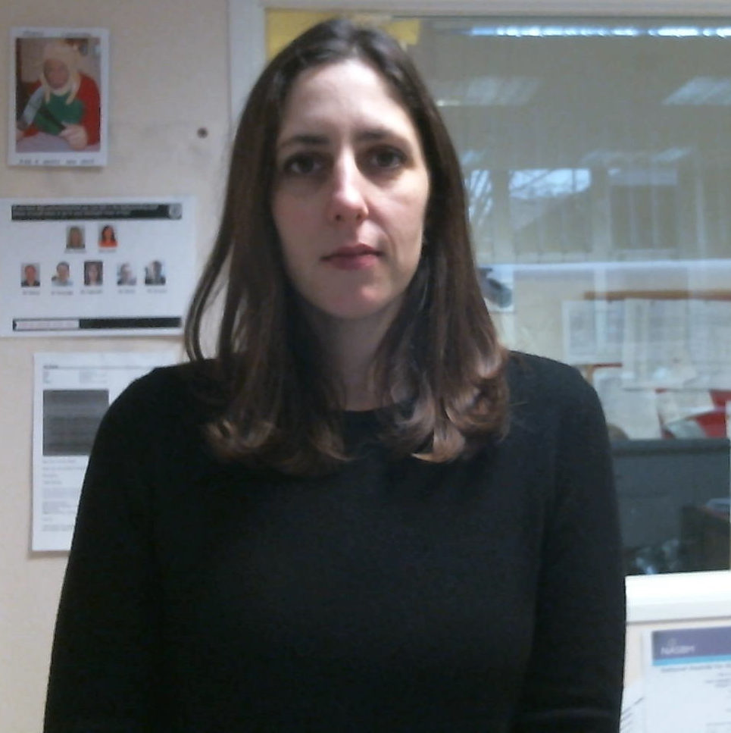
Supertutors
Ms Berry
Mr Gimson
Ms Patel
Ms Mortimer
Ms Greenbank

Slide 22
Cheney iPads
Passcode: 1920

Slide 23
Student finance 2019
Emily Jones

Slide 24
Main topics
What are the costs?
How will students pay for it?
What are the repayments?

Slide 25
What are the costs?
Two main costs:
Tuition Fees
Living Costs

Slide 26
Tuition fees: Undergraduate
£6,165 - £9,250 per year 2019 entry
(Check individual universities and courses for details)
Oxford Brookes University
£9,250 per year
Undergraduate degrees taught at Oxford Brookes

Slide 27
Tuition fees: Foundation degrees
Foundation degree costs may differ to onsite degrees
Oxford Brookes University
£7,395 per year / £9,250 for top up year
(Foundation/Bachelor degrees taught in
Further Education Colleges)

Slide 29
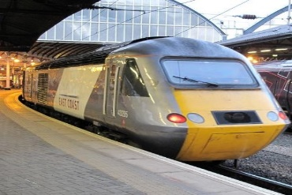
Living costs

Slide 30
How will students pay for it all?
Non-Repayable
Sources
LOANS
Tuition fee loan
Maintenance loan
Bursaries
Scholarships

Slide 31
Tuition fee loan
£6,165 - £9,250 per year 2019 entry
Tuition fee available to all
Fees are paid directly to the university

Slide 32
Maximum maintenance loan allowance
Students living at home with parents | Up to £7,324
Students living away from home (Outside of London) | Up to £8,700
Students living away from home (Studying in London) | Up to £11,354
*means tested

Slide 33
Maintenance loan scale
Income | Maximum
£25,000 | £8,700
£30,000 | £8,076
£35,000 | £7,452
£40,000 | £6,828
£45,000 | £6,204
£50,000 | £5,579
£55,000 | £4,955
£60,000 | £4,331
£62,215+ | £4,054
NB - Living away from home outside London

Slide 34
How do the loans work?
Loans combined into one amount
Repayments start:
April after the course finishes
Student earning at least £25,000 per year
Interest Rates
Loan wiped after
30 years
HMRC

Slide 35
repayments
Repay tuition fee and maintenance loan at:
9% of income over £25,000
Salary | Repayment
£25,000 | £0 per month
£30,000 | £37 per month
£35,000 | £75 per month

Slide 36
PAYSLIP
Name | Mr. A. Non | Pay Date | 28th April
NI number | NI12345A | Tax Code | AB12
Earnings |  | Deductions
Salary | £2,500 | Tax | £302.50
 |  | National Insurance | £215.76
 |  | Student Loan | £37.00
Total Pay | £2,500 | Total Reductions | £555.26
 |  | Net Pay | £1,944.74

Slide 37
How will students pay for it all?
Non-Repayable
Funding
LOANS
Tuition fee loan
Maintenance loan
Bursaries
Scholarships

Slide 38
Bursaries and scholarships
Cash bursaries
Fee waivers
Halls
discount
University specific
financial packages
Check university
websites for details

Slide 39
Bursaries and scholarships
Oxford Brookes Bursary Up to £2,000 per year Community Scholarship £1,000 (1st year only) (eligible schools and college available on website) Transition from Care Bursary Up to £2,000 per year Sports Scholarships Up to £2,000 per year Estranged Student Bursary Up to £2,000 per year Tessa Jane Evans Bursary for Nursing

Slide 40
Applying for student finance
1
Fill in and send application online:
www.gov.uk/student-finance
2
Application assessed
3
Financial Notification letter sent

Slide 41
Applying for student finance
4
Online declaration form signed and sent to SFE
5
Payment Schedule Letter sent
6
The student will not receive instalments until they have enrolled with a university

Slide 42
Other help
Disabled Student Allowance
www.gov.uk/disabled-students-allowances-dsas
Processed by Student Finance England
Wellbeing can offer advice
Support available for dyslexic students
- One to One study skills support
- Exam provisions
- Equipment or software
- Non-medical helpers

Slide 43
ADDITIONAL INFORMATION
The fees given are for the 2018/19 academic year. Please note tuition fees may increase in subsequent years both for new and continuing students in line with an inflationary amount determined by government. Oxford Brookes University intends to maintain its fees for new and returning home and EU students at the maximum permitted level for new and returning Home / EU students.
We aim to provide helpful and accurate information regarding any additional course costs that you may incur as a student which are not included in your course fees.
This information is updated regularly and can be found for every course and is available on the prospectus web pages under ‘This Course in Detail’ section.
www.brookes.ac.uk
We aim to provide helpful and accurate information regarding any additional course costs that you may incur as a student which are not included in your course fees.
This information is updated regularly and can be found for every course and is available on the prospectus web pages under ‘This Course in Detail’ section.
Notes:
Placement expenses under review.
PLU representatives can answer specific questions regarding placements.

Slide 44
Useful websites
FINANCE:
www.gov.uk/student-finance
www.brookes.ac.uk/studying-at-brookes/finance/
www.nhsbsa.nhs.uk/students
(Health Care & Social Care courses)
www.thestudentroom.co.uk

Slide 45
Main topics
What are the costs?
How will students pay for it?
What are the repayments?

Slide 46
What are the costs?
Two main costs:
Tuition Fees
Living Costs

Slide 47
Foundation degrees
Foundation degree costs may differ to onsite degrees
Oxford Brookes University
£7,000 per year / £9,250 for top up year
or campus based courses
(Foundation/Bachelor degrees taught in
Further Education Colleges)
Notes:
Art & Design foundation course free under 19
2 year FD. 1 Year top up.
FD on campus, such as Equine, will be £9250

Slide 48
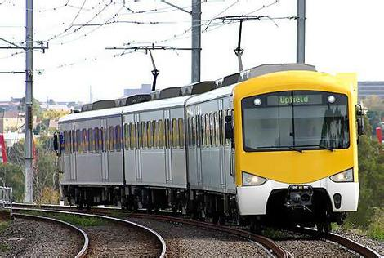
Living costs

Slide 49
How will students pay for it all?
Non-Repayable
Sources
LOANS
Bursaries
Scholarships
Disabled Students Allowance
Tuition fee loan
Maintenance loan

Slide 50
Tuition fee loan
£6,000 - £9,250 per year 2018 entry
Tuition fee available to all
Fees are paid directly to the university
Notes:
Under 25 classed as a dependent and they need the support of a parent or guardian. We appreciate that there are those under 25 who are already living independent- talk to student finance England about your status.
Over 25 classed as independent
Absolute deadline is May 31st to get loan for sept.
Not means tested.
You need to make the application every year – if your situation changed this can be reflected
Studying abroad – eligible for tuition but not maintenance

Slide 51
MAINTENANCE LOAN
To help pay for living costs
All full-time UK students eligible
Means-tested

Slide 52
Maximum maintenance loan allowance
Students living at home with parents | Up to £7,324
Students living away from home (Outside of London) | Up to £8,700
Students living away from home (Studying in London) | Up to £11,354
Students living away from home (Abroad) | Up to £9,963
Notes:
Lots of people are choosing to do this now and you still do get money – living at home
Means tested
London includes anywhere in the M25, including Royal Holloway.
.

Slide 53
Maintenance loan scale
Income | Maximum
£24,999 and below | £8,700
£25,000 | £8,076
£30,000 | £7,452
£35,000 | £6,828
£45,000 | £6,204
£50,000 | £5,579
£55,000 | £4,955
£60,000 | £4,331
£62,215 and above | £4,054
NB - Living away from home outside London

Slide 54
How do the loans work?
Loans combined into one amount
Repayments start:
April after the course finishes
Student earning at least £25,000 per year
Interest Rates
Loan wiped after
30 years
Inland Revenue
Student loans do not impact credit score
Notes:
This is frozen until 2021 - £21k
Beginning of the next tax year.
Linked with the tax man – when you apply you give them your NI number
Interest – RPI+3% starts accruing on day 1 you start the course, that’s why it’s important to go on open days to know you're making the right decision

Slide 55
repayments
Repay tuition fee and maintenance loan at:
9% of income over £25,000
Salary | Repayment
Up to £25,000 | No repayment
£30,000 | £30 per month
£35,000 | £67 per month
£45,000 | £142 per month
Notes:
Sliding scale

Slide 56
PAYSLIP
Name | Mr. A. Non | Pay Date | 28th April
NI number | NI12345A | Tax Code | AB12
Earnings |  | Deductions
Salary | £2,500 | Tax | £308.33
 |  | National Insurance | £218.36
 |  | Student Loan | £30.00
Total Pay | £2,500 | Total Reductions | £556.69
 |  | Net Pay | £1,943.31
Notes:
Works the same as a tax – you don’t even see the money go
Moving abroad – they will calculate the national wage and that would be the benchmark
Example of someone earning 25000

Slide 57
Bursaries and scholarships
Cash bursaries
Fee waivers
Halls
discount
University specific
financial packages
Check university
websites for details

Slide 58
Additional support
DSA
ADULT DEPENDENTS
GRANT
LONGER COURSE SUPPORT
r
PARENTS’ LEARNING ALLOWANCE
CHILDCARE
GRANT
Notes:
Longer course support: Travel bursary £300
January starts – see us afterwards
Parents learning allowance: help with course costs if you have dependent children, income dependent
Childcare grant: weekly allowance if you have dependent children in child care. Amount depending on no. of children.
Adult dependents – if an adult depends on you. Amount dependent on income
DSA (disabled students’ allowances) – about needs –
need to apply for all. See gov. website for more info. For instance compute, software, 1:1 study skills support, mentoring, IT training
Paramedic – check with Charlie W before the talk
Possible additional costs covered by the government
Social Work -
The Tessa Jane Evans Bursary for Nursing – 3 available. UP to £3k, for up to 3 years.

Slide 59
Bursaries and scholarships
Oxford Brookes Bursary Up to £2,000 Community Scholarship £1,000 (1st year only) (for Oxfordshire state schools and colleges only) Transition from Care Bursary Up to £2,000

Slide 60
Applying for student finance
1
Fill in and send application online:
www.gov.uk/student-finance
2
Application assessed
3
Financial Notification letter sent
Notes:
Schools and colleges should give you lots of support – it is a lengthy process at the beginning there's a lot of paperwork
You can use your ucas id and it will prepopulate lots for you
You don’t have to wait until you have all your offers, you can start this asap

Slide 61
Applying for student finance
4
Online declaration form signed and sent to SFE
5
Payment Schedule Letter sent
6
The student will not receive instalments until they have enrolled with a university
Notes:
Payment schedule letter – can take up to 6 weeks to come

Slide 62
Useful websites
FINANCE:
www.gov.uk/student-finance
www.brookes.ac.uk/studying/finance
www.nhsbsa.nhs.uk/students
(Social Care courses)
BROOKES:
www.brookes.ac.uk

Slide 63
ALL YOU NEED TO KNOW ABOUT UNIVERSITY
www.unipodadvice.com

Slide 64
Useful websites
Government: www.gov.uk/studentfinance
Student Room: www.thestudentroom.co.uk/studentfinance
Brookes: www.brookes.ac.uk/studying/finance
NHS: www.nhsbsa.nhs.uk/students
(NHS and Social Care courses)

Slide 65
Useful Websites
http://www.practitioners.slc.co.uk/resources/201516-resources/resources-to-share-with-parents.aspx

Slide 66
Date | Event | Follow up action
Thursday 14th March | Year Twelve visit to UCAS Convention at Brunel University | Attend this and other Open Days in the late summer
Study Skills Lessons | Writing draft Personal Statements | Fill in UCAS form during tutor time after summer half term
Monday 3rd to Friday 7th June | UCAS Predictor Exams | Complete work experience and writing of Personal Statement
Monday 10th to Friday 14th June | Work Experience Week | Get supervisor to send feedback to tutor. Sign up for a ‘UCAS completion slot’ in the autumn.
Friday 13th September | UCAS early applicants (Oxbridge, Medicine etc.) school deadline | Submit UCAS form as early as possible and by the relevant deadline at the very latest
Monday 14th October | Cheney final deadline for all UCAS applications
Notes:
The Form and the Schedule:
Detailed guidance on how to fill out the UCAS form can be found on the UCAS website and in the 2019 booklet which you can access via the Cheney website – an updated version for 2020 will be available by the second half of the summer term. Our schedule for completing it is as above.
In June we will be asking all students to sign up for a particular week in which their UCAS form will be prepared. The aim is that each tutor will have two references to complete per week, and that I will have twelve forms to send, meaning that I can complete 144 forms – my expected total, in the twelve weeks from 3rd September to 2nd December. Early applicants will need to get slots in the first five weeks.

Slide 67
Helpful YouTube Video
https://www.youtube.com/watch?v=5jQ3MJgdkJY - detailed guidance from UCL on how to write a Personal Statement. There are may other videos available on YouTube – have a look and let me know what you find useful.

Slide 68
Helpful Radio Programmes
http://www.bbc.co.uk/programmes/b05xhwr2 - My Life on Paper
http://www.bbc.co.uk/programmes/b013fmcn - How to write a Personal Statement

Slide 69
On Wednesday 27th March, from 3.30 to 6pm, over fifty visiting organisations will be running stalls and activities, including…

Slide 70
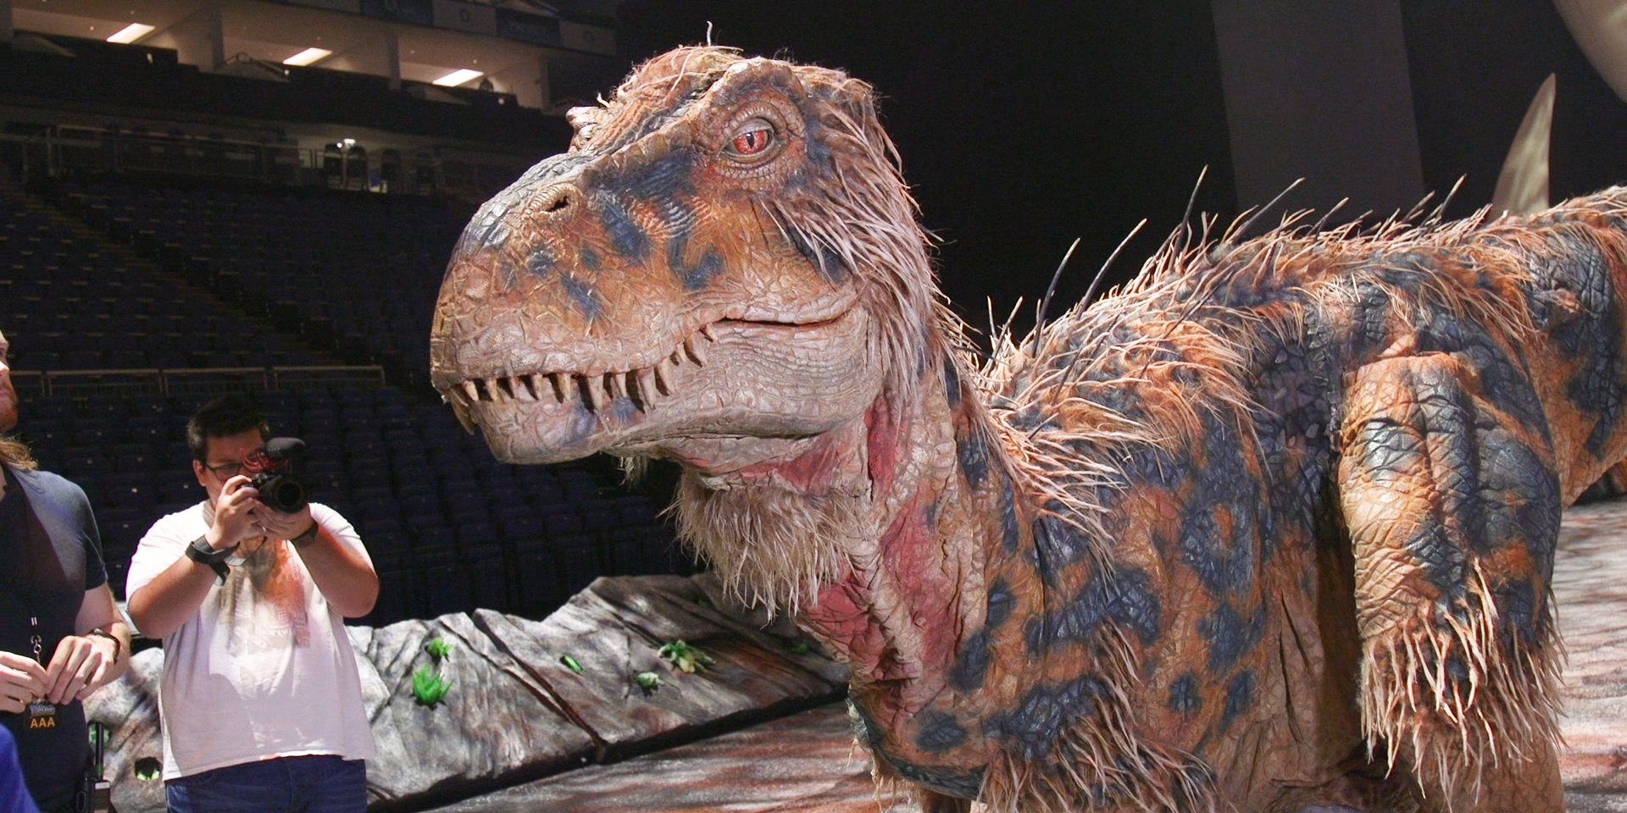
Animatronic Dinosaurs

Slide 71
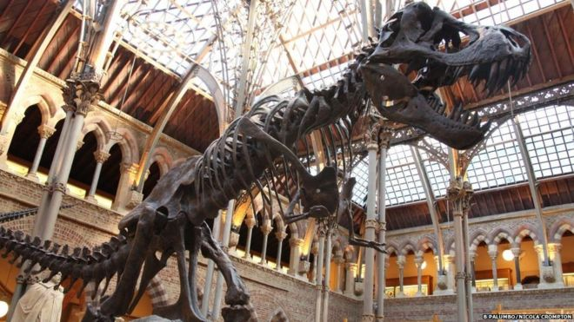
Oxford Natural History Museum

Slide 72
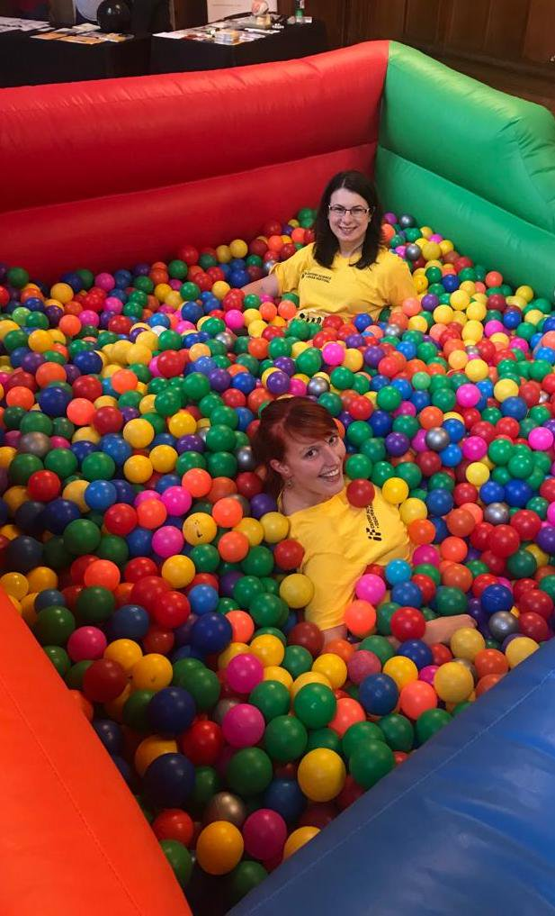

Slide 73
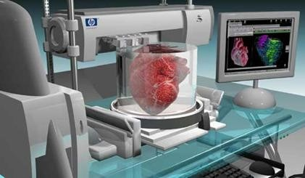
https://

Slide 75
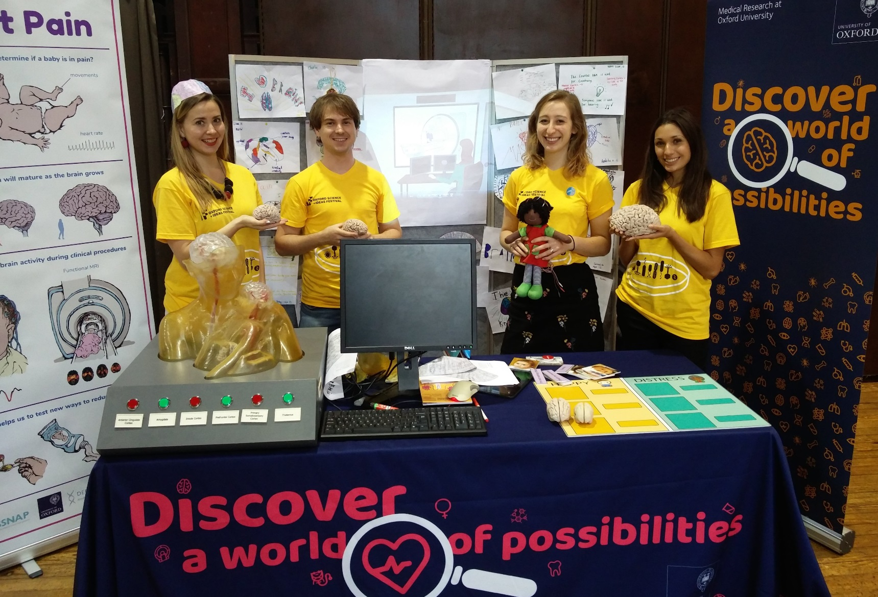

Slide 77
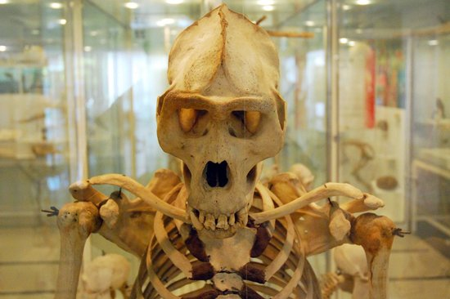
Cole Museum of Zoology

Slide 78
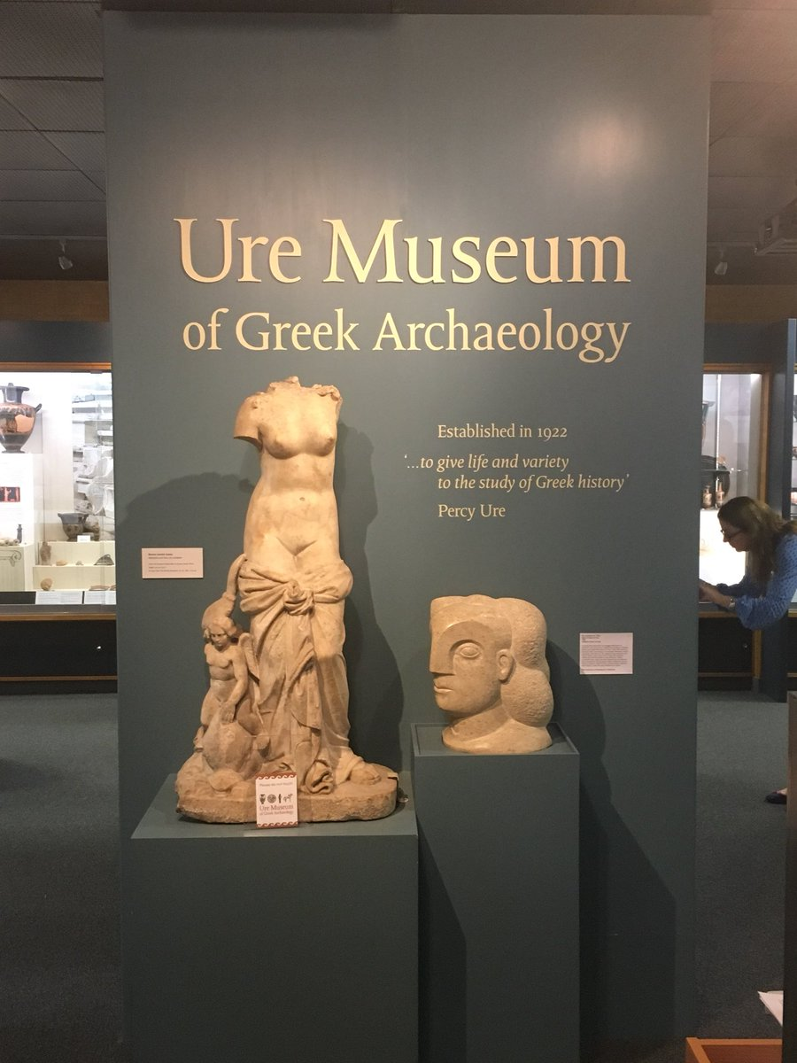

Slide 80
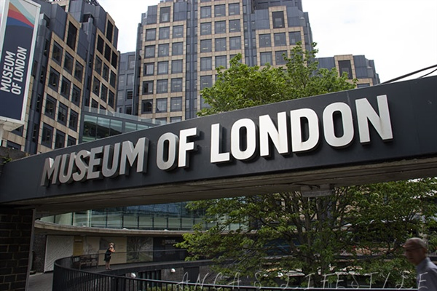

Slide 81
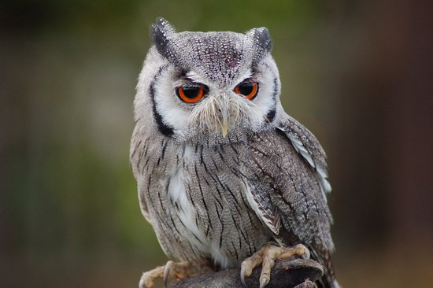
Birds of Prey Display

Slide 83
As well as all these stalls, there will be speakers in the Assembly Hall including…

Slide 84
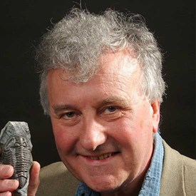
Professor Richard Fortey, a TV Palaeontologist, on Dinosaurs

Slide 85
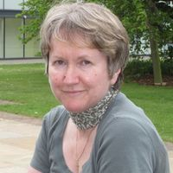
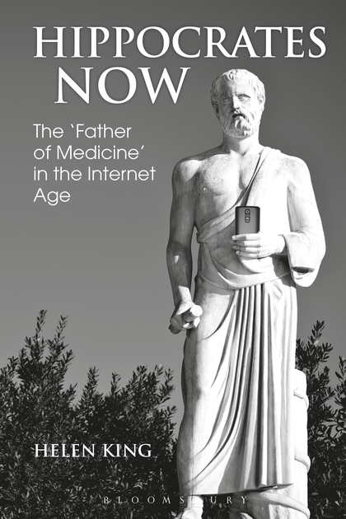
Professor Helen King on Ancient Medicine

Slide 86
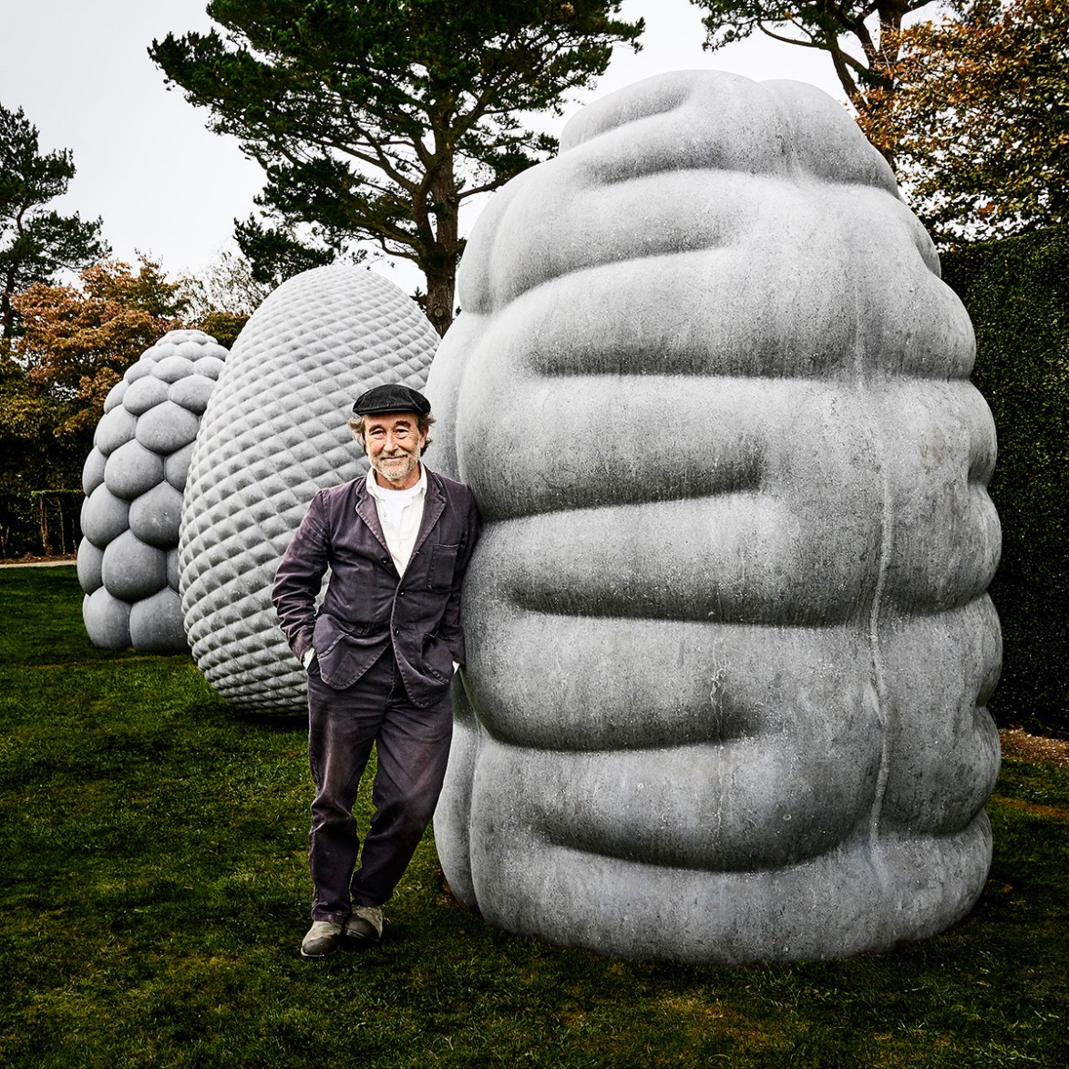
Peter Randall-Page, a nationally acclaimed sculptor

Slide 87
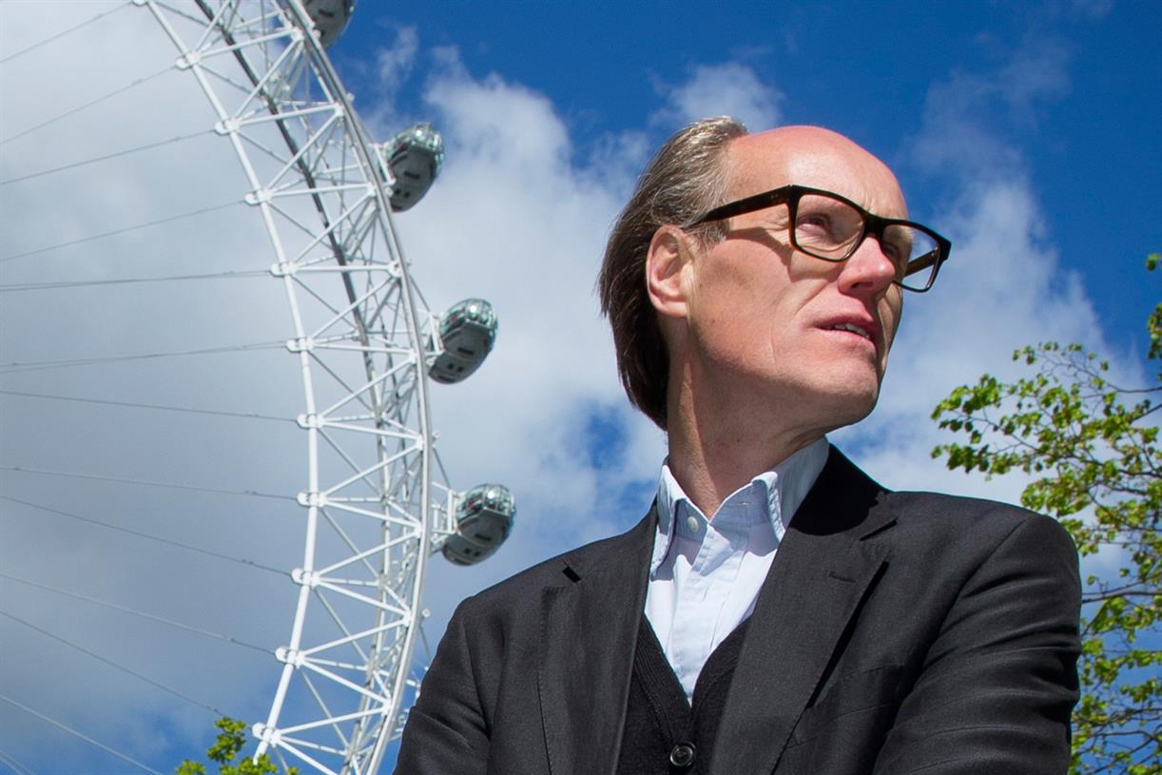
Will Gompertz, Chief Arts Editor for the BBC

Slide 88
Don’t miss out! Be there straight after school on Wednesday 27th March, 3.10 – 6pm – ground floor of Brighouse and Lane, Assembly Hall, Library and outside!

Slide 90
Feedback
Please put the small green feedback sheet in the box at the door as you leave.
Thank you.

